Slide 1
Superconductive Magnetoresistive Random-Access Memory (JMRAM)
By
Charles Nathan Cardinell
Mentor
Nathan Newman

Slide 2
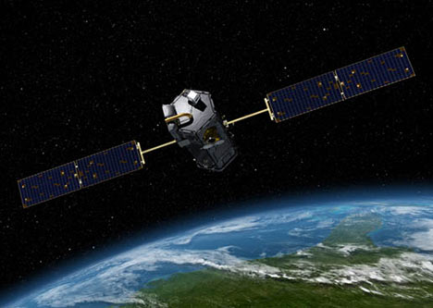
Objective
To create a RAM that requires very little power
Resistive to Radiation Damage
Fast Switching

Slide 3
Memory Comparision
JMRAM has a faster read/write time
JMRAM is low power
JRAM has high endurance
 | FLASH | DRAM | SRAM | JMRAM (projected)
Cell Size (μm^2) | 0.04 | 0.03 | 0.3 | <1.25
Read Time (ns) | 10 - 50 | 10 | 1 | <5
Write Time | .1 - 100 ms | 10 ns | 1 ns | <5 ns
Write Energy per Bit | 10 nJ | 5 pJ (Requires Refresh) | 5 pJ | 4 - 10 pJ
Endurance (read/write) | 10^15/10^5 | 10^15 | 10^15 | 10^15
Non-Volatillitile | Yes | No | No | Yes

Slide 4
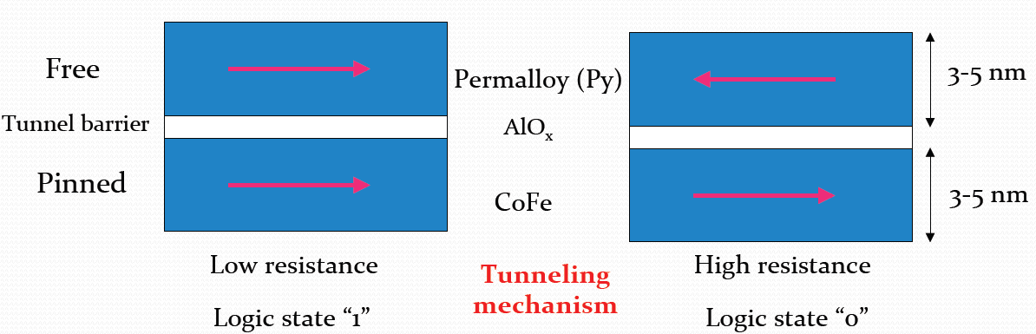
Review of Magnetoresistive Random-Access Memory (MRAM)
Non-Volatile
Data stored as a magnetic element

Slide 5
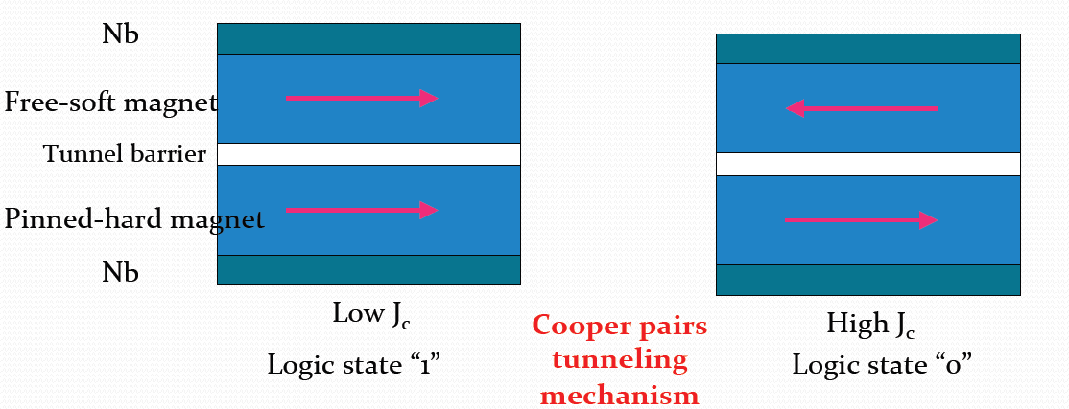
Review of Superconductive Magnetoresistive Random-Access Memory (JMRAM)
Uses Josephson Junctions
Faster then Normal MRAMs

Slide 6
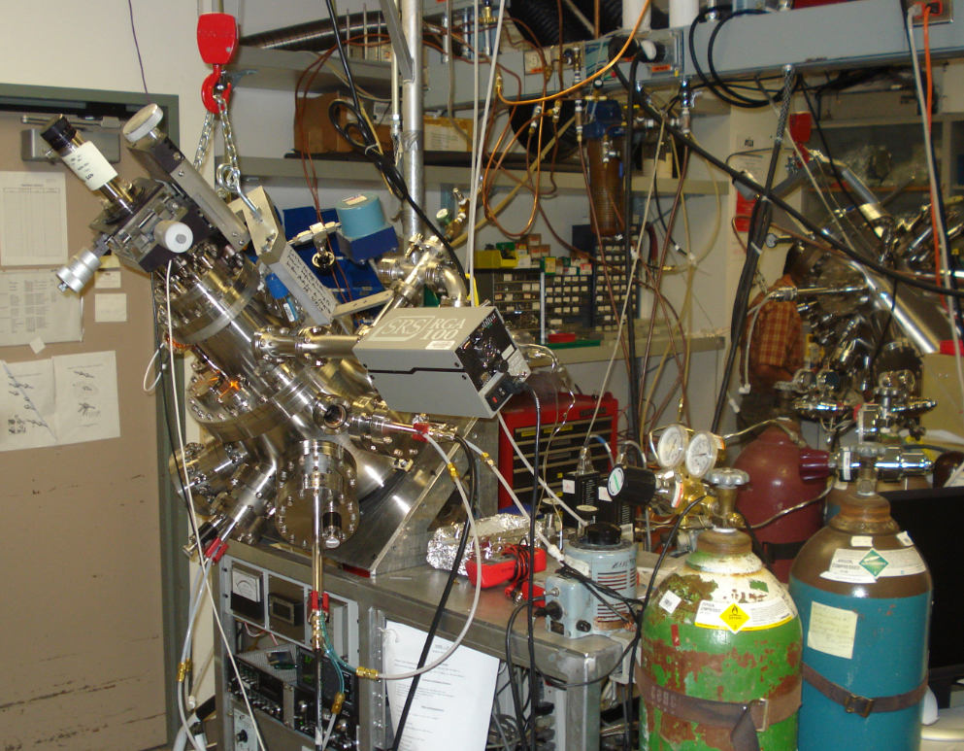
Growth of the JMRAM
(Ultra-High Vacuum) UHV chamber
4 guns and targets
Large temperature range
Vacuum to 10⁻⁹ Torr
Sapphire and Silica substrates

Slide 7
Types of Devices
Shadow Mask
Processed
Advantages
  Cheap
  Fast
Disadvantages
  Larger Device Area
  Poorer Quality Films
  Less Consistant
Advantages
  Multiple Device Sizes
  Multiple Devices
  Better Quality Films
  Less Pin Holes
Disadvantage
  Expensive
  More Chances for a mistake to occur

Slide 8
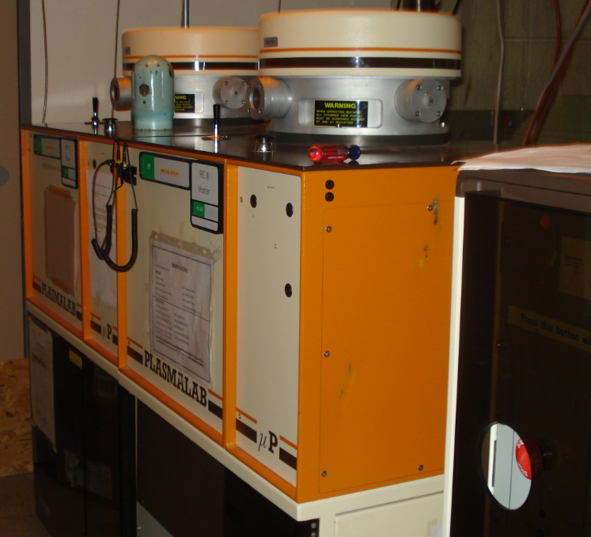
Processing of the JMRAM
Step #1: Reduced Working Area Etch
Step #2: Junction Definition Etch
Step #3: Silica Dioxide Deposition
Step #4: Via Etch
Step #5: Metal Liftoff

Slide 9
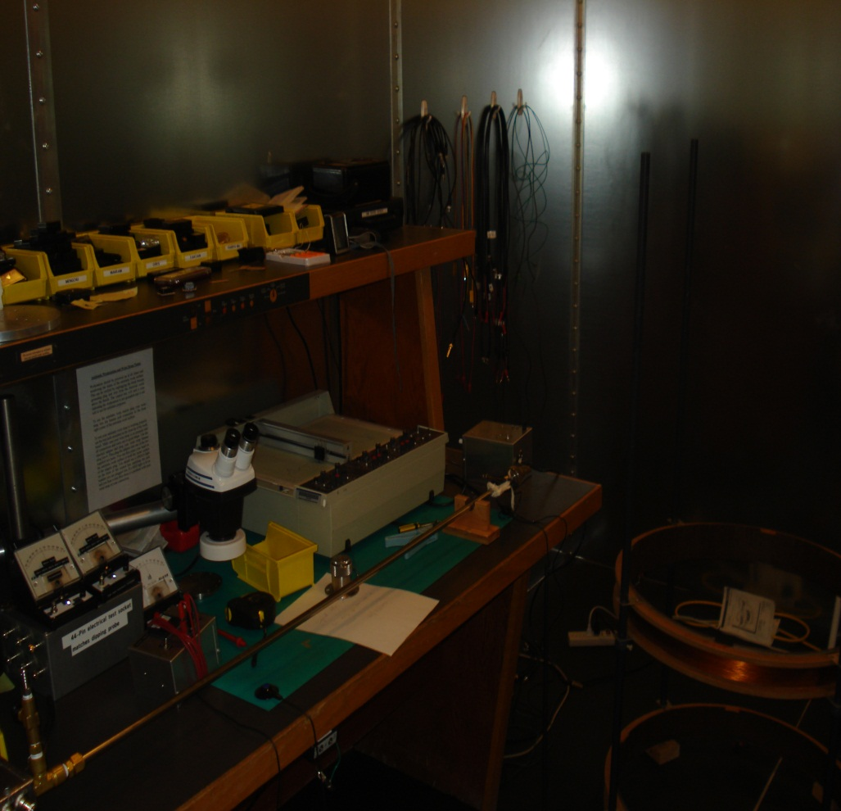
Measuring the JMRAM
Done in a shielded room
Wide range of temperatures and magnetic fields
Digital Systems Used

Slide 10
Results

Slide 11
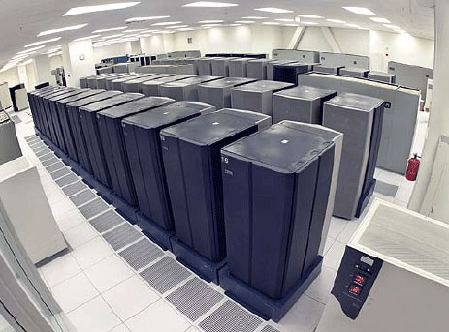
Conclusions
JMRAM has the possibility to be used in a wide range of areas such as
Satellites
Banks
Search Engines
Databases

Slide 12
Thank you
Questions?

